Slide 1
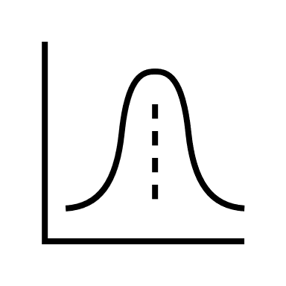
Evaluation of probabilistic forecasts of time series
Laura Frølich
Python study group
April 15th 2021
Predicted distribution
Observation, was prediction good or bad?

Slide 2
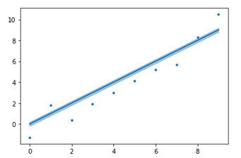
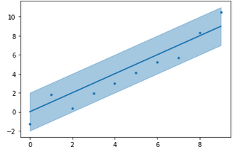
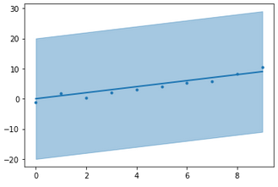
Why evaluate predicted probabilities?
Check that predicted probabilities correspond to real probabilities
Cannot evaluate forecast for single observation

Slide 3
What does a probabilistic forecast need to satisfy to be useful?
Reliability, aka Calibration
Overall correspondence between predicted probability of event and fraction of that event out of all observations.
Compares forecasts to observations.
Sharpness
Width of prediction intervals, the narrower the better to encourage forecasts to have as little uncertainty as possible.
Looks only at forecasts.
Resolution
Spread of predicted distributions must be small relative to climatology to ensure changes true uncertainty are reflected in predictions.

Slide 4
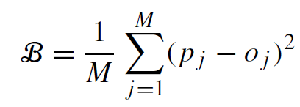

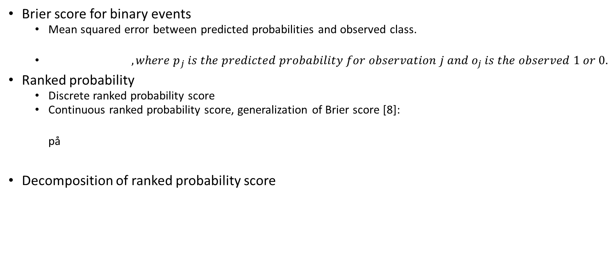
Evolution of scores
Brier score for binary events
Mean squared error between predicted probabilities and observed class.
$, where p_{j} is the predicted probability for observation j and o_{j} is the observed 1 or 0.$
Ranked probability
Discrete ranked probability score
Continuous ranked probability score, generalization of Brier score [8]: på
Decomposition of ranked probability score

Slide 5
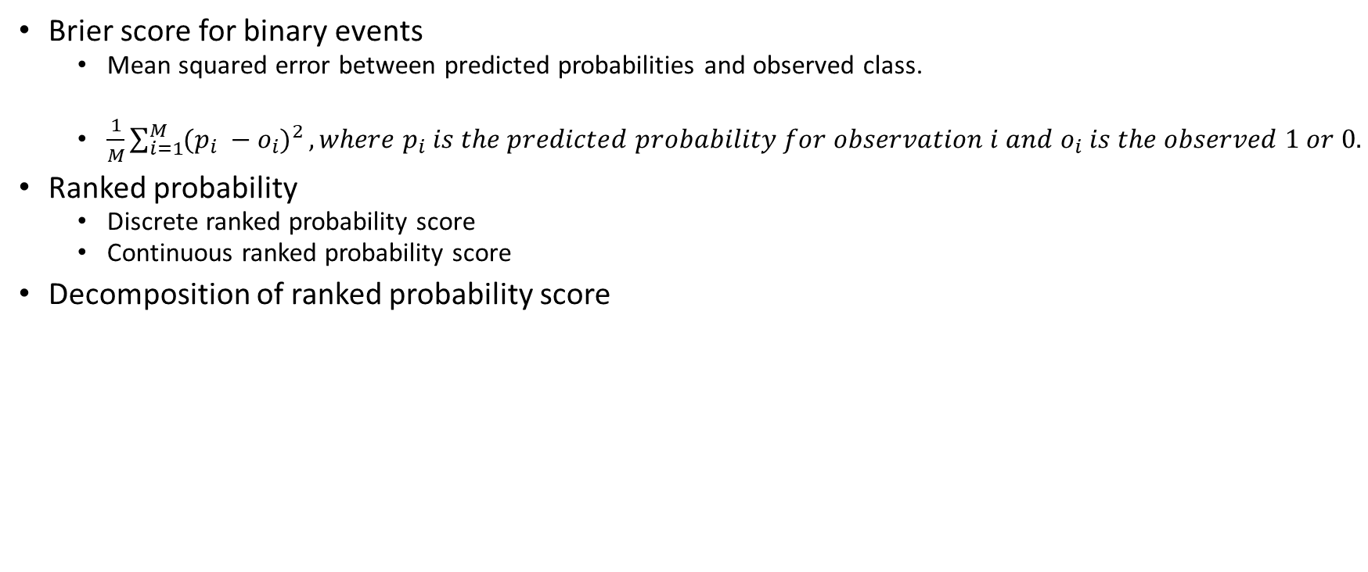
HIDDEN Evolution of scores
Brier score for binary events
Mean squared error between predicted probabilities and observed class.
$\frac{1}{M}\sum_{i=1}^{M}{{(p_{i} −o_{i})}^{2}}, where p_{i} is the predicted probability for observation i and o_{i} is the observed 1 or 0.$
Ranked probability
Discrete ranked probability score
Continuous ranked probability score
Decomposition of ranked probability score

Slide 6
Reliability/calibration
Binary outcomes
If the outcome is observed about 80% of the time that a probability of 0.8 was predicted, the forecaster is said to be calibrated (reliable) at 0.8.
If a forecaster is calibrated (reliable) at all probabilities that are predicted, then the forecaster is said to be calibrated (reliable).
Assessed with reliability diagram.
Continuous variable
Ranks of realized values in predicted distribution should be uniformly distributed.
Let X be a random variable and define P(X<x)=F(x).
Then F(X)~U(0, 1) since P(F(X) < y) = P(X < F⁻¹(y)) = F(F⁻¹(y)) = y
Since the observations follow the true underlying distribution (G) which we approximate with a predicted distribution (F), we will have the above case if F is the same as G.
Assessed with rank histogram
For each observation, find its rank in the ensemble forecast. Plot the histogram showing the number of observations falling between each pair of forecast members.

Slide 7
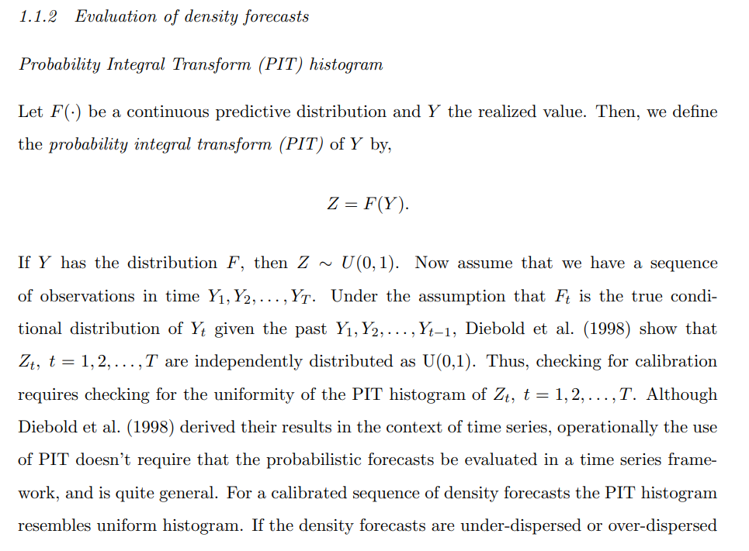
Notes:
http://datascienceassn.org/sites/default/files/Combining%20and%20Evaluating%20Probabilistic%20Forecasts.pdf p.25

Slide 8
Sharpness/resolution
“For a calibrated forecast, it quantifies sharpness; for an uncalibrated forecast, it measures potential sharpness.” [1]
Binary outcomes
A forecast is said to be sharp if predicted probabilities are near 0 and 1.
Continuous variable
The less uncertainty, the sharper the forecast

Slide 9
Sources
http://datascienceassn.org/sites/default/files/Combining%20and%20Evaluating%20Probabilistic%20Forecasts.pdf
https://sites.stat.washington.edu/raftery/Research/PDF/Gneiting2007jrssb.pdf
https://www.cawcr.gov.au/projects/verification/#Methods_for_probabilistic_forecasts
https://en.wikipedia.org/wiki/Probability_integral_transform
https://www.springer.com/gp/book/9780387979748 p. 322
https://machinelearningmastery.com/how-to-score-probability-predictions-in-python/
https://rmets.onlinelibrary.wiley.com/doi/epdf/10.1256/qj.04.71
https://journals.ametsoc.org/view/journals/mwre/135/7/mwr3414.1.xml?tab_body=fulltext-display

